Slide 1
Early Stage Diabetes Prediction
Machine Learning Project
By: Rizwal Abrol

Slide 2
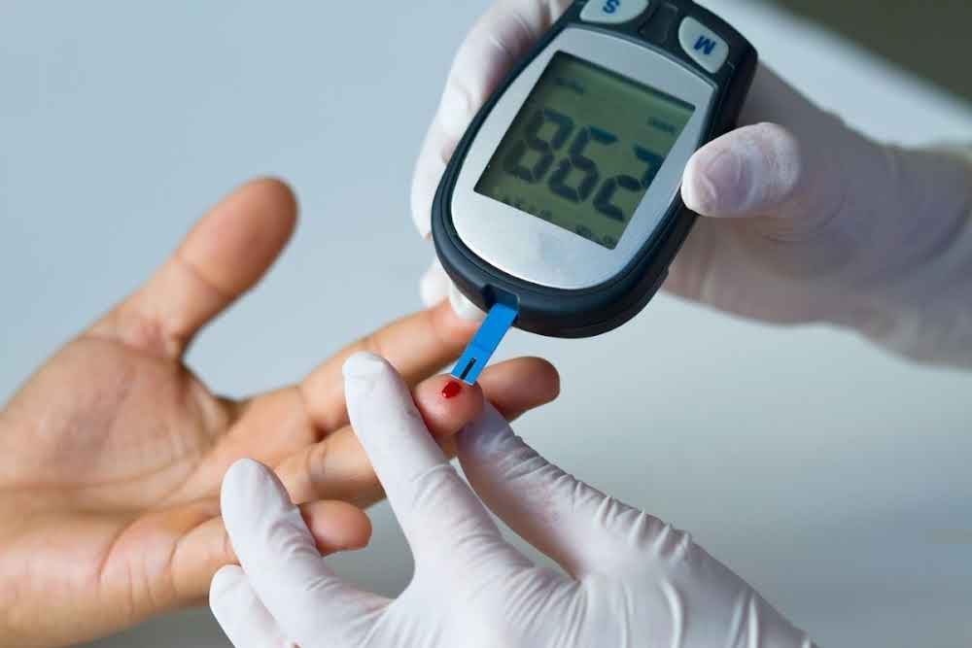
What is Diabetes?
Diabetes is a chronic (long-lasting) health condition that affects how your body turns food into energy. Your body breaks down most of the food you eat into sugar (glucose) and releases it into your bloodstream. When your blood sugar goes up, it signals your pancreas to release insulin.

Slide 3
Dataset Characteristics
Associated Tasks: Classification
Attributes: 17
Instances: 520
This data has been collected using direct questionnaires from the patients of Sylhet Diabetes Hospital in Sylhet, Bangladesh and approved by a doctor.
Link: https://archive.ics.uci.edu/dataset/529/early+stage+diabetes+risk+prediction+dataset

Slide 4
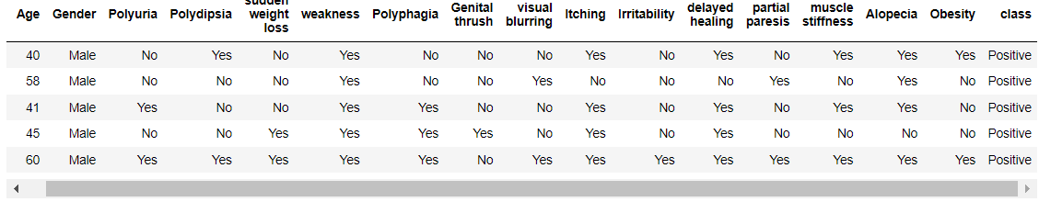
Dataset Format

Slide 5
Platform and Libraries used
Platform:
Jupyter Notebook
Libraries:
Pandas
Numpy
Matplotlib
Seaborn
Catboost
Xgboost
sklearn

Slide 6
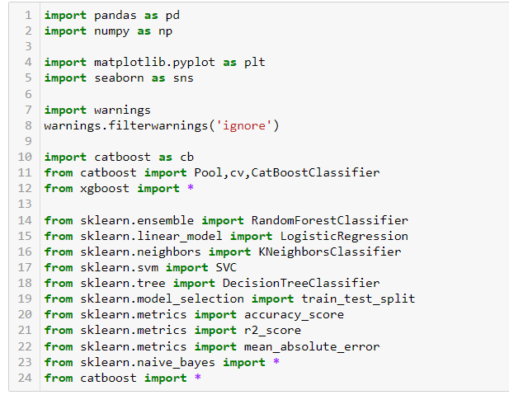
Steps I took to make ML model
Importing Libraries

Slide 7
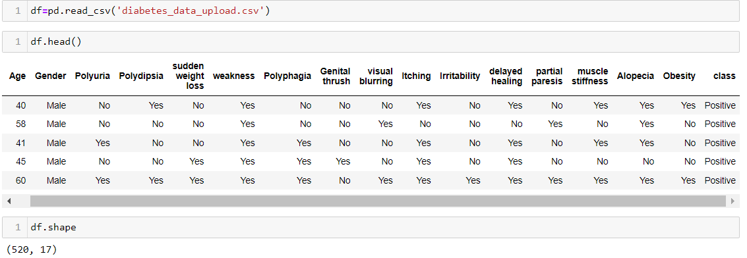
Loading Dataset

Slide 8
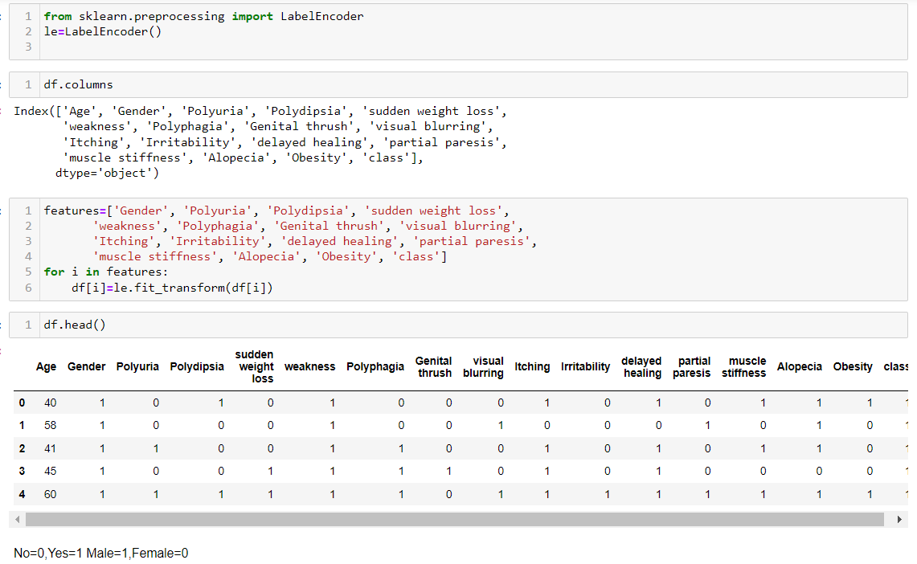
Data Preprocessing

Slide 9
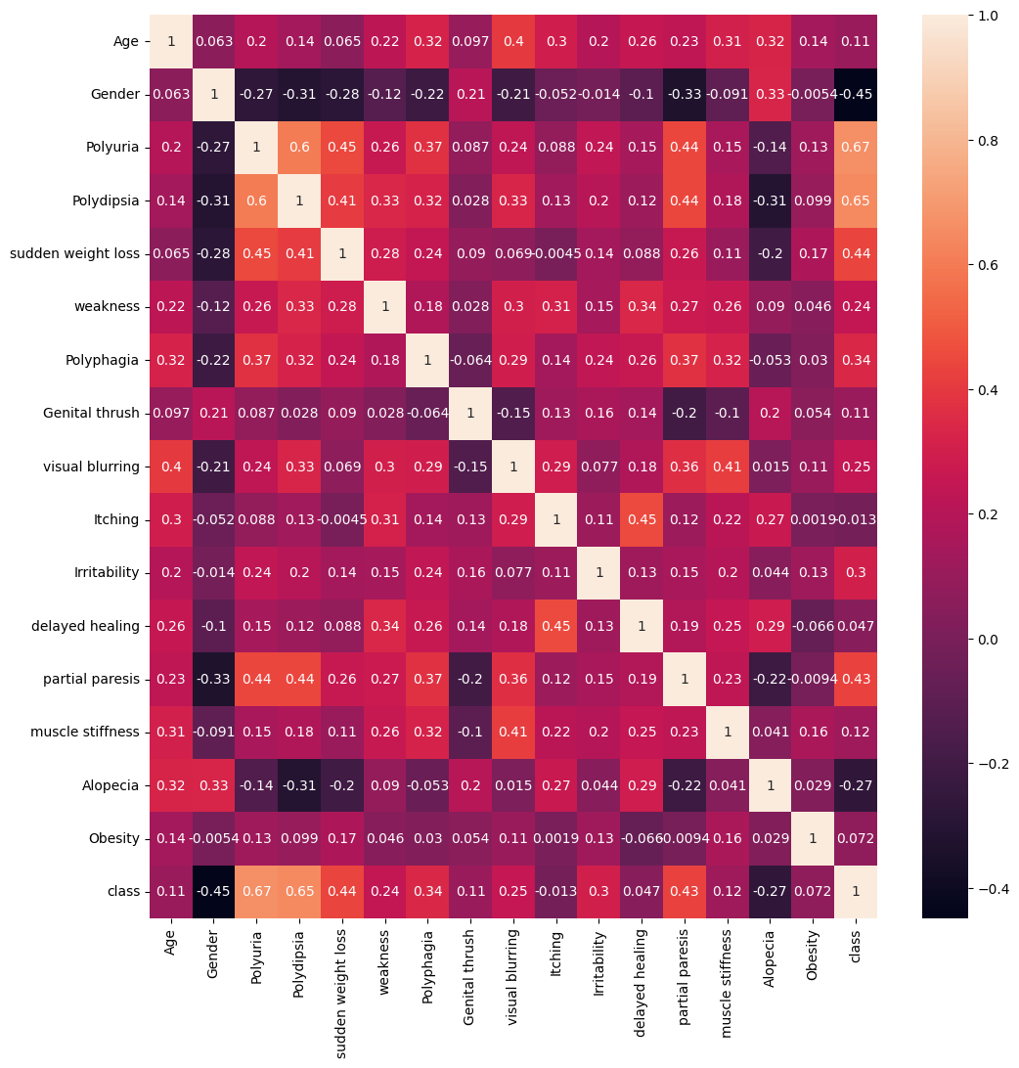
Feature Importance using Heatmap

Slide 10
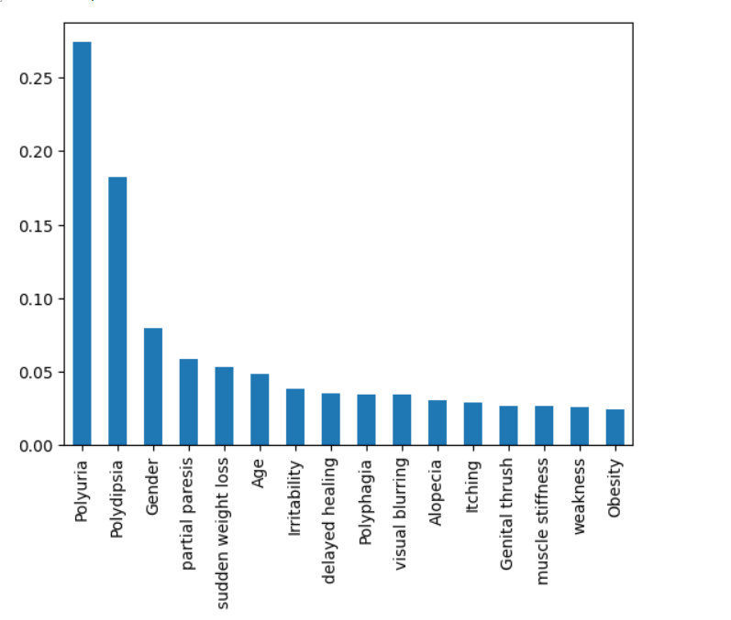
Feature Importance using ExtraTreesClassifier

Slide 11
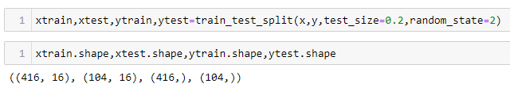
Splitting of data

Slide 12
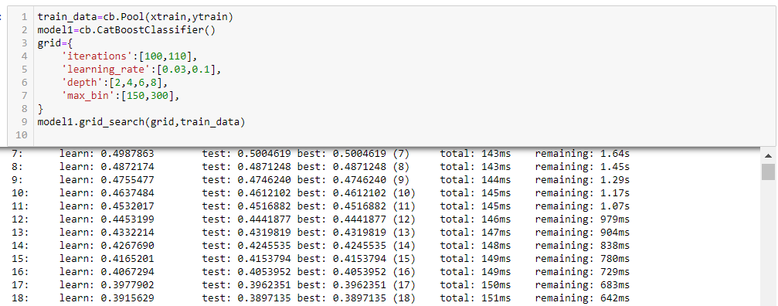
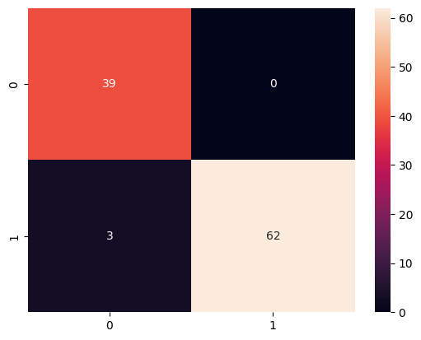
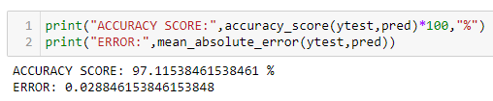
Catboost Model for training

Slide 13
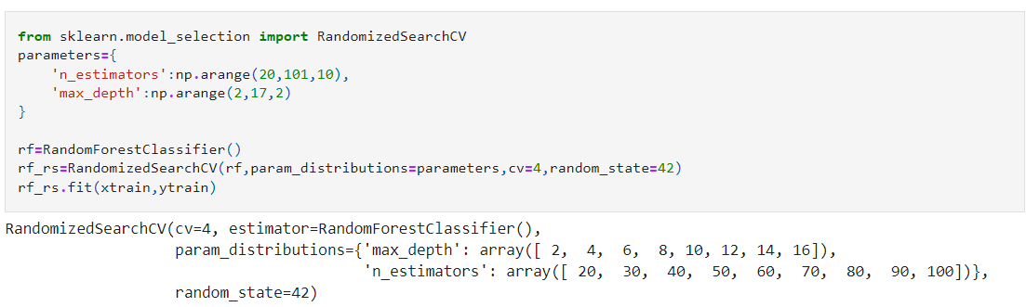
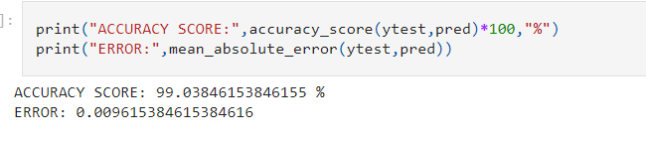
RandomForest Model

Slide 14
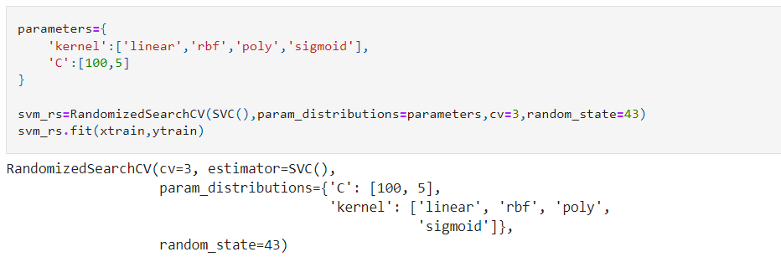
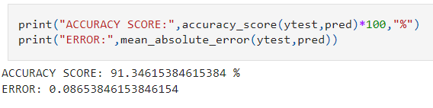
SVC Model

Slide 15
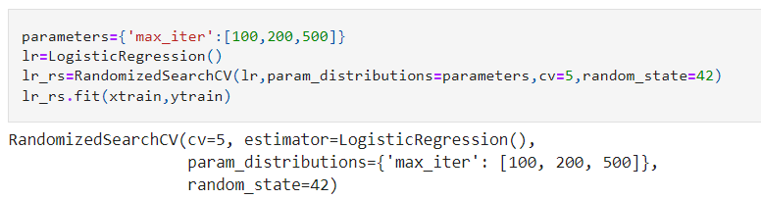
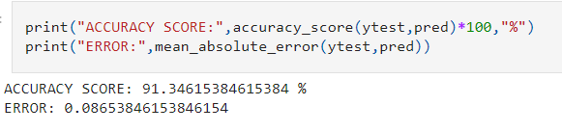
Logistic Regression Model

Slide 16
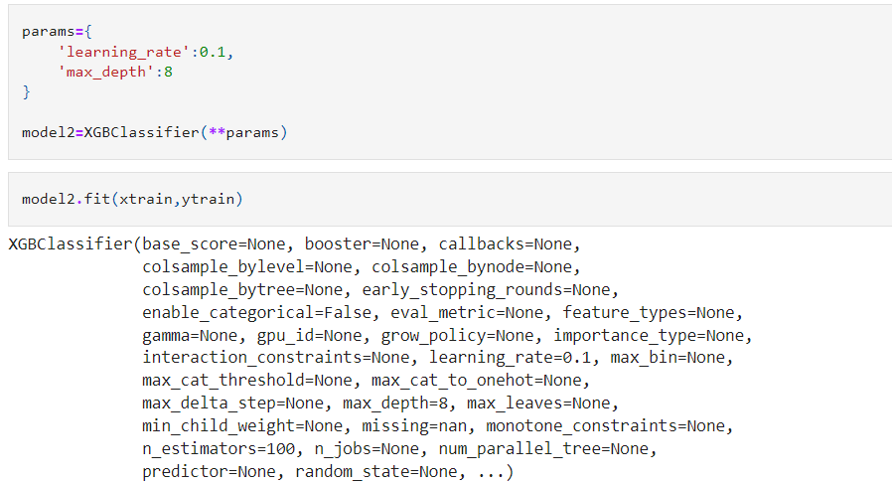
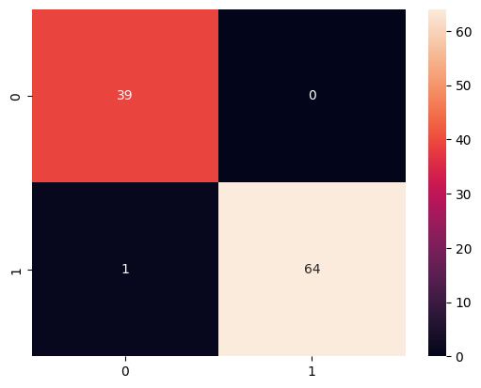
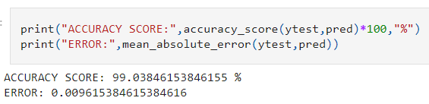
XGBoost Model

Slide 17
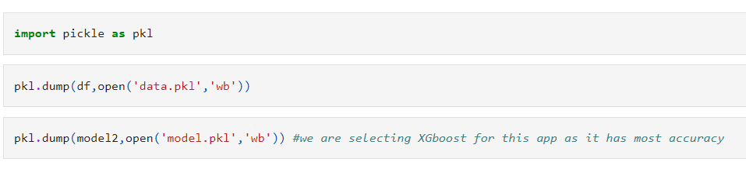
Conclusion
By hyperparameter and cross validation, We got to know that XGBoost and Random Forest gives the best prediction result with accuracy of approx. 99% and error nearly close to 0.
Now by leveraging XGBoost model,the results were then integrated into a web application using Pickle and Streamlit, providing a user-friendly platform for disease prediction

Slide 18
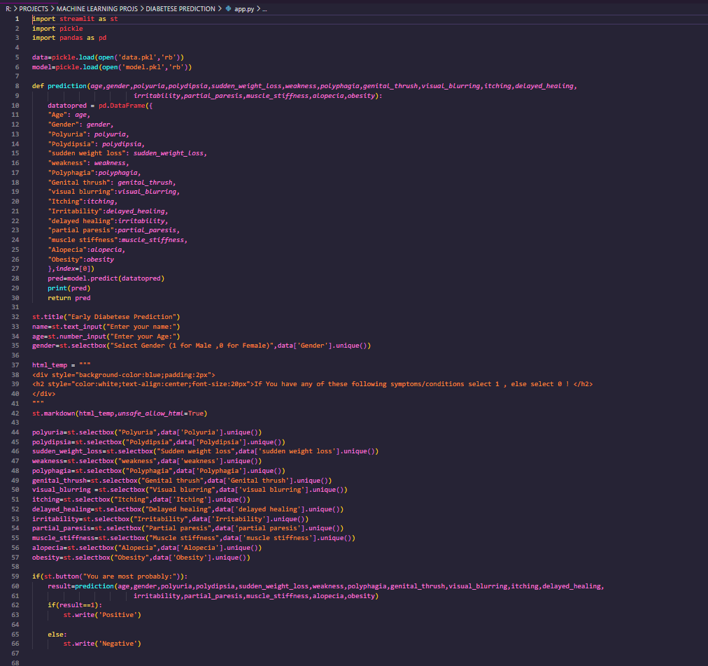
Web app (code)

Slide 19
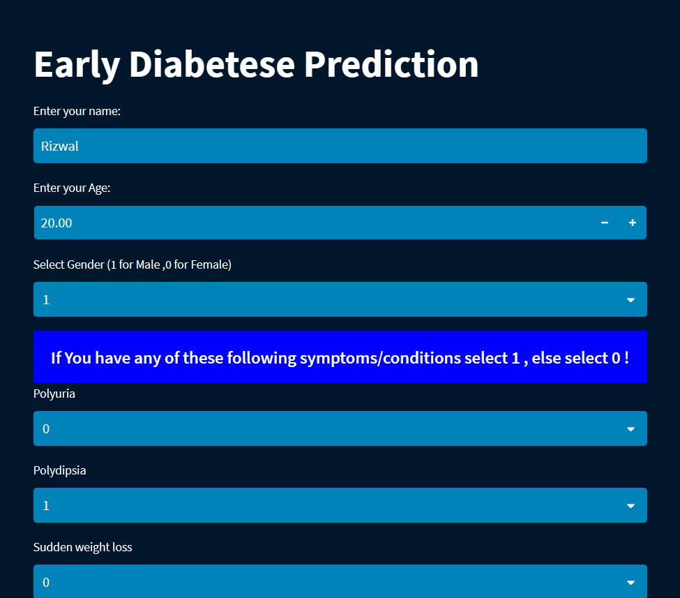
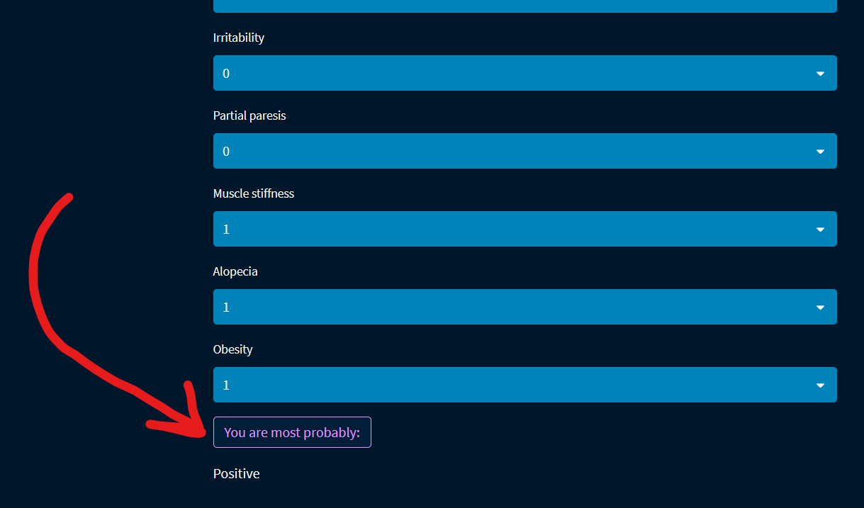
Web app

Slide 20
Checkout the whole project here:
https://github.com/Rizwal/Early-Stage-Diabetes-Prediction

Slide 21
Thank you!

